Slide 1
Process Management
Process
Process Life Cycle
PCB
Process Hierarchy
Context Switching
PCB
Process Creation
fork
clone
vfork
Types of Processes
Orphan
Zombie
Deamon

Slide 2
Programs, Processes, and Threads
The source code which you have implemented or the compiled binary, executable code lying in the system’s disk storage is called Program.
Large programs designed for a specific task is called Application Program.
Ex: /bin/ls , /bin/mkdir, etc
A process is a running program.
A process includes the binary image loaded into memory, an instance of virtualized memory, kernel resources such as open files, a security context such as an associated user, and one or more threads.
A process is a running program.
A process includes the binary image loaded into memory, an instance of virtualized memory, kernel resources such as open files, a security context such as an associated user, and one or more threads.
A process is a running program.
A process includes the binary image loaded into memory, an instance of virtualized memory, kernel resources such as open files, a security context such as an associated user, and one or more threads.
A process is a running program.
A process includes the binary image loaded into memory, an instance of virtualized memory, kernel resources such as open files, a security context such as an associated user, and one or more threads.
A process is a running program.
A process includes the binary image loaded into memory, an instance of virtualized memory, kernel resources such as open files, a security context such as an associated user, and one or more threads.
A thread is the unit of activity inside a process.
Each thread has its own virtualized processor, which also includes a stack, processor state, registers, and an instruction pointer.

Slide 3
Process Address Space
(Every process have its own Address Space)
Name | Interpretation
Code Segment (also known as Text segment) | Executable statements of the program
Data Segment. Three categories Initialized Data Zero-Initialized or BSS data RODATA | The respective interpretation of categories: Statically allocated or global data that are initialized with non-zero values Uninitialized data Strings will be stored here
Heap Segment | Source of Dynamic memory allocation
Stack Segment | Local variables of the scope. Function parameters Variables stored on the stack "disappear" when the function containing them returns and the space on the stack is reused for subsequent function calls.

Slide 4
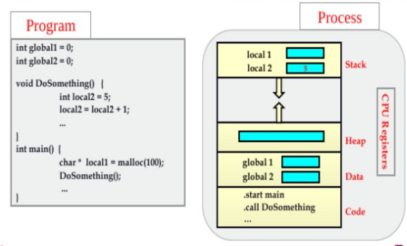
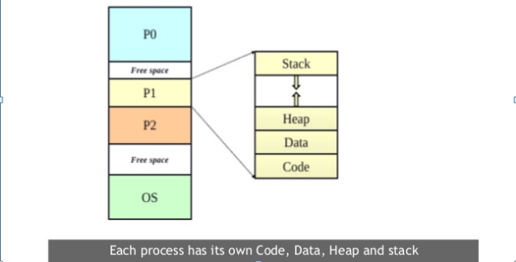
Program →Process

Slide 5

State Transition Diagram

Slide 6
OS Control Structures
An OS maintains the following tables for managing processes and resources:
Memory tables
I/O tables
File tables
Process tables
OS Functions related to Processes
Process management: Process creation, termination, scheduling, dispatching, switching, synchronization, IPC support, management of PCBs
Memory management: Allocation of address space to processes, swapping, page and segment management.
IO management: Buffer management, allocation of IO channels and devices to processes.
Support functions: Interrupt handling, accounting, monitoring.

Slide 7
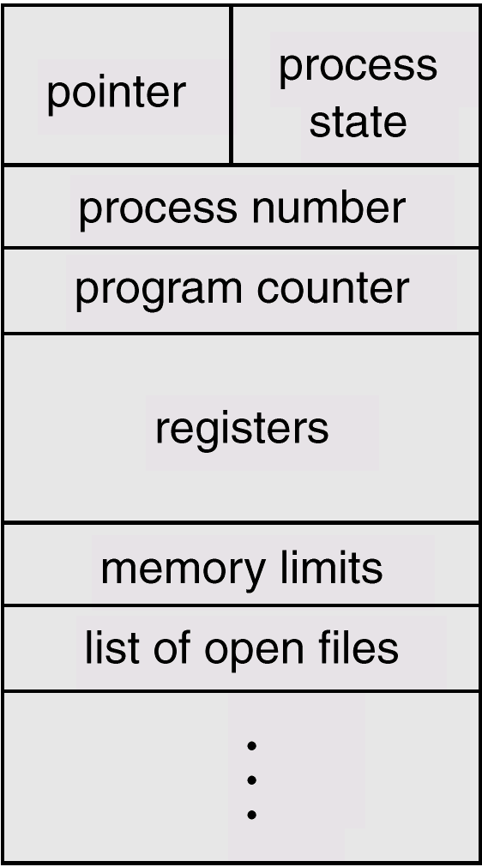
Process Control Block (PCB) or Process Descriptor
It's a data structure holding:
PC, CPU registers,
memory management information,
accounting ( time used, ID, ... )
I/O status ( such as file resources ),
scheduling data ( relative priority, etc. )
Process State (running, suspended, etc. is simply a field in the PCB ).

Slide 8
Pointer – It is a stack pointer which is required to be saved when the process is switched from one state to another to retain the current position of the process.
Process state – It stores the respective state of the process.
Process number – Every process is assigned with a unique id known as process ID or PID which stores the process identifier.
Program counter – It stores the counter which contains the address of the next instruction that is to be executed for the process.
Register – These are the CPU registers which includes: accumulator, base, registers and general purpose registers.
Memory limits – This field contains the information about memory management system used by operating system. This may include the page tables, segment tables etc.
Open files list – This information includes the list of files opened for a process.

Slide 9
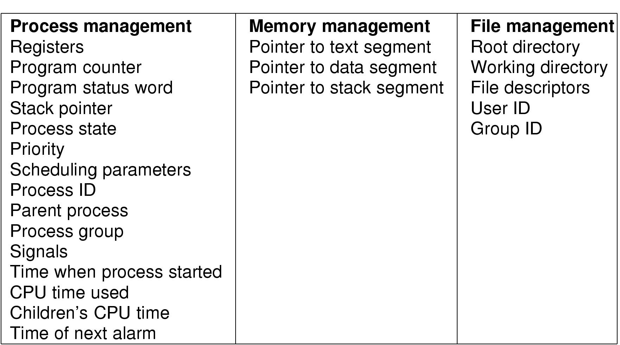
Process Table Entry (PCB)

Slide 10
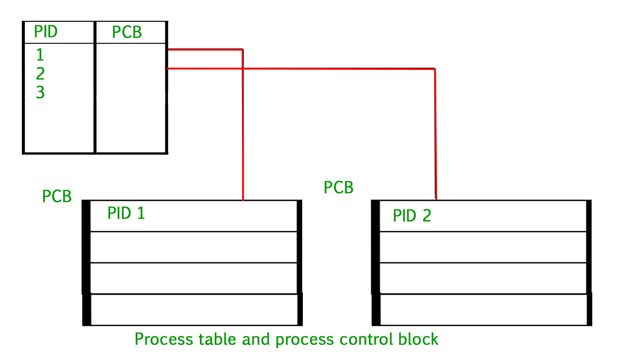

Slide 11
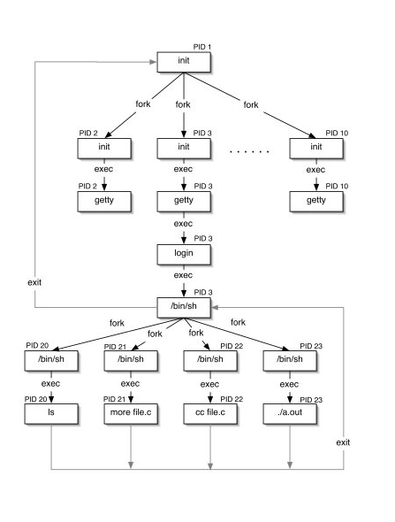
Process Hierarchy

Slide 12
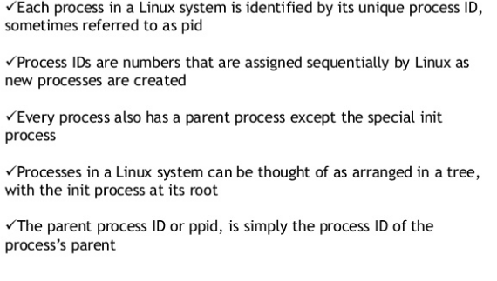
Process ID

Slide 13
The process that spawns a new process is known as the parent process.
The new process is known as the child process.
Each process is represented by a unique identifier, the process ID (frequently shortened to pid)
The pid is guaranteed to be unique at any single point in time.
The idle process, which is the process that the kernel “runs” when there are no other runnable processes, has the pid 0.
The first process that the kernel executes after booting the system, called the init process, has the pid 1
By default, the kernel imposes a maximum process ID value of 32768

Slide 14
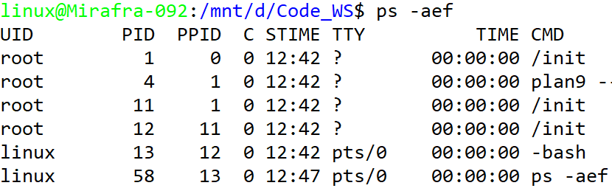
APIs to get Process and Parent Process ID
getpid() return the process id of current process
pid_t getpid(void)
getppid() returns the process id of parent of the current process
pid_t getppid(void)
Command to Check Processes Running on Linux System
ps command displays the processes running on Linux System

Slide 15
Context Switching
Switching the CPU to another task requires saving the state of the old task and loading the saved state for the new task is called context switching.
The time wasted to switch from one task to another without any disturbance is called scheduling jitter
After scheduling, the new process gets hold of the processor for its execution

Slide 16
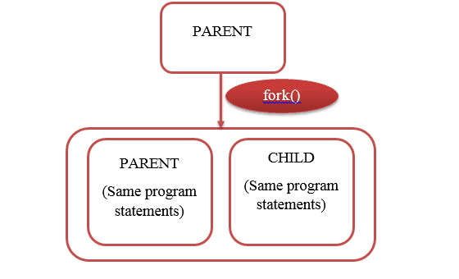
Process Creation
fork
fork() creates a new process by duplicating the calling process.
The new process is referred to as the child process.
The calling process is referred to as the parent process.
Both parent and child process execute the same program after fork() is called and both run parallelly
The child process and the parent process run in separate memory spaces.
At the time of fork() both memory spaces have the same content.
Memory writes, file mappings (mmap()), and unmappings (munmap()) performed by one of the processes do not affect the other.
The child process is an exact duplicate of the parent process except for
the following points:
The child has its own unique process ID
The child's parent process ID is the same as the parent's process ID.
The child does not inherit its parent's memory locks

Slide 17
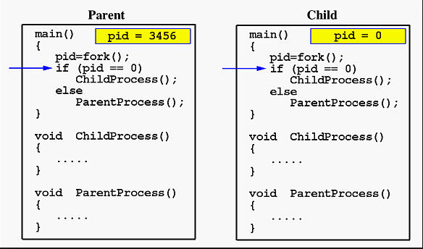
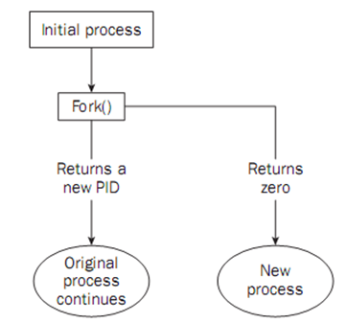
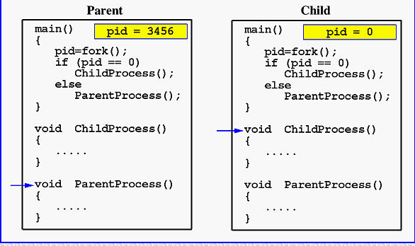
fork continue….

Slide 18
Inherited by the child from parent
process credentials (real/effective/saved UIDs and GIDs)
environment
stack
memory
open file descriptors (note that the underlying file positions are shared between the parent and child, which can be confusing)
close-on-exec flags
signal handling settings
nice value
scheduler class
process group ID
session ID
current working directory
root directory
file mode creation mask (umask)
resource limits
controlling terminal

Slide 19
Unique to the child
process ID
different parent process ID
Own copy of file descriptors and directory streams.
process, text, data and other memory locks are NOT inherited.
process times, in the tms struct
resource utilizations are set to 0
pending signals initialized to the empty set
timers created by timer_create not inherited
asynchronous input or output operations not inherited

Slide 20
Sample code using fork system call
int main(void)
{
pid_t pid;
pid=fork();
if (pid==0)
{
printf("I am a child process\n");
printf(“Child process ID : %d \n", getpid());
printf("Child's Parent process ID : %d ",getppid());
}
else
{
printf("I am a parent process\n");
printf(“Parent process ID : %d \n",getpid());
printf("Parent's parent ID(Shell id) : %d\n",getppid());
}
}

Slide 21
Types of Processes
Orphan Process
After fork(), the time slice is given to parent process. If the parent process terminates before the child process, then the child process becomes orphan process
When parent terminates then the child process will come into the picture of init process
For every orphan process init will become father
int main(void)
{
pid_t pid;
pid=fork();
if (pid==0)
{
sleep(5);
printf("I am a child process\n");
printf(“Child process ID : %d \n", getpid());
printf("Child's Parent process ID : %d ",getppid());
}
else
{
printf("I am a parent process\n");
printf(“Parent process ID : %d \n",getpid());
printf("Parent's parent ID(Shell id) : %d\n",getppid());
}
}

Slide 22
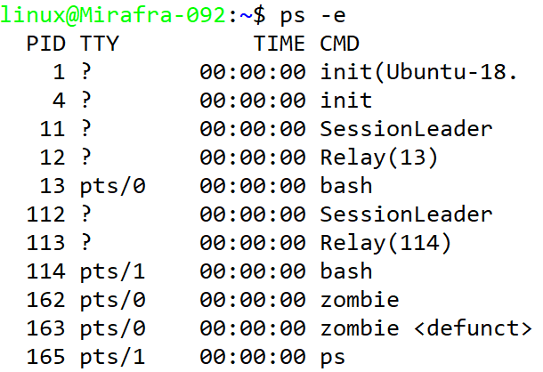
Zombie Process
A zombie process (also called a defunct process) in Linux is a child process that has completed execution, but still has an entry in the process table because its parent hasn't read its exit status.
int main(void)
{
pid_t pid;
pid=fork();
if (pid==0)
{
printf("I am a child process\n");
printf(“Child process ID : %d \n", getpid());
printf("Child's Parent process ID : %d ",getppid());
}
else
{
getchar();
printf("I am a parent process\n");
printf(“Parent process ID : %d \n",getpid());
printf("Parent's parent ID(Shell id) : %d\n",getppid());
}
}
$ gcc zombie.c $./a.out & $ ps –el

Slide 23
Daemon Process
Daemon are processes that live for a long time .
They run in the background
They don’t have controlling terminal
Daemons doesn’t want to get killed when the shell exits
$ ./a.out &
Example : INIT PROCESS =1

Slide 24
Exec system call
exec replaces the current process image with a new process image
Text, Data, BSS and stack of the calling process are overwritten by that of the program loaded
The program invoked inherits the calling process’s PID and any open file descriptors that are not
set to close on exec
Signals pending on the calling process are cleared
Any signals set to be caught by the calling process are reset to their default behavior
int main(void)
{
pid_t pid;
pid = fork();
if (pid == 0) {
printf("Child Process\n");
execl("/bin/ls","ls","-l",(char *)0);
printf (“This won’t Print”);
}
else
printf("Parent Process\n");
}

Slide 25
exec flavors
int execl(char * pathname, char*arg0, …, (char *)0)
int execle(char * pathname, char*arg0, …,(char *)0)
int execv(char * pathname, char*argv[])
int execve(char * pathname, char*argv[], char *envp[])
int execlp(char *filename, char*arg0, …,(char *)0)
int execvp(char *filename, char*argv[])
Note: l – List & v - Vector

Slide 26
Process Termination
There are 3 ways for normal termination
Executing a return from main
Calling an exit function ( Library Call )
Calling _exit function ( System Call )
There are 4 ways for an abnormal termination
Suicide : Exit in the middle
Accident : Segmentation Violation
Murder : SIGKILL by Parent Process
Massacre : During Shutdown

Slide 27
Wait & Waitpid
wait function suspends execution of the current process until a child has exited or until a signal is delivered whose action is to terminate the current process or call a signal handling function
waitpid functions suspends execution of the current process until a child as specified by the pid argument has exited or until a signal is delivered whose action is to terminate the current process or to call a signal handling function.
If the child has already exiting by the time of the call ( Zombie Process) the functions returns immediately. Any system resources used by the child are freed
Syntax:
pid_t wait ( int *status)
pid_t waitpid ( int pid, int *status, int options)

Slide 28
Sample Code using wait system call:
int main(void)
{
pid_t pid;
pid = fork();
if (pid == 0)
{
printf("I am a child process\n");
printf("child process ID : %d \n", getpid());
printf("Child's Parent process ID : %d \n",getppid());
exit(0);
}
else
{
printf("Parent Process\n");
cpid = wait(&status);
printf("Child Id is %d and status is %d\n",cpid,status);
if ( (status & 0xff) != 0)
printf("Process Terminated Abnormally\n");
else
printf("Process Terminated Normally\n");
}
}

Slide 29
clone
Create a child process
Clone is a library function layered on top of the underlying clone system call
This call allow the child process to share parts of its execution context with the calling process such as the memory space, table of file descriptors and the table of signal handlers
Main use of clone is to implement THREADS
Since the child and calling process may share memory, it is not possible for the child process to execute the same stack as the calling process. Therefore the calling process must setup memory space for the child stack and pass a pointer to this space
Stack grows downwards on all processors that run Linux, so child stack usually points to the topmost address of the memory space setup for the child stack
Syntax:
int clone(
int (*fun)(void *arg),
void *child_stack,
int flags,
void *arg
)

Slide 30
clone flags:
Flags can be used to specify what is shared between the calling process and the child process
CLONE_PARENT Parent of new child process is same as that of calling process
CLONE_FS The caller and the child process share the same file system information.
This includes the root of the file system, current working directory, the umask.
Any call to chroot, chdir, umask performed by the calling process or the child process also takes effect in the other process
CLONE_FILES The calling process and the child process share the same file descriptor table.
File descriptors always refer to the same files in the calling process and in the child process. Any file descriptor created by the calling process or by the child process is also valid in the other
CLONE_SIGHAND: The calling process and the child process share the same table of signal handlers.
If the calling process or child process calls sigaction to change the behavior associated with
a signal, the behavior is changed in the other process also. However the calling process and child process still have distinct signal masks and sets of pending signals. So one of them may block or unblock some signals using sigprocmask without affecting the other process
CLONE_PTRACE The calling process is being traced then trace the child also

Slide 31
CLONE_VFORK The execution of the calling process is suspended until the child releases its virtual memory resources via a call to execve or exit. If not set parent and child are schedulable separately
CLONE_VM The calling process and the child process run in the same memory space. In particular, memory writes performed by the calling process or by the child process are also visible in the other process. Moreover any memory mapping or unmapping performed with mmap or munmap by the child or calling process also affects the other process
CLONE_PID The child process is created with the same process ID as the calling process
CLONE_THREAD The child thread is placed in the same thread group as the calling process
On success the PID of the child process is returned in the callers thread of execution

Slide 32
Sample code using clone system call:
int main()
{
int *st,k=9;
st = (int *)malloc(2000)+2000;
pid_t p1;
p1 = clone(myfn(k),st,SIGCHLD,NULL);
if(p1<0)
perror("error in fork:");
printf("before child.....................\n");
if(p1==0)
printf("i am in child...............");
else
printf("i am from parent.......................\n");
}
int myfn(int kk)
{
printf("i am from child fun %d.....................\n",kk);
}

Slide 33
vfork
Create a child process and block parent
pid_t vfork(void)
vfork is a special case of clone
If is used to create a new process without coping the page tables of the parent process
vfork differs from fork in that the parent is suspended until child makes a call to execve or exit
Child shares all memory with its parent including the stack until execve is issued by the child and once execve syscall’ed child will get the separate address space.
Signal handlers are inherited but not shared. Signals to the parent arrive after the child releases the parent

Slide 34
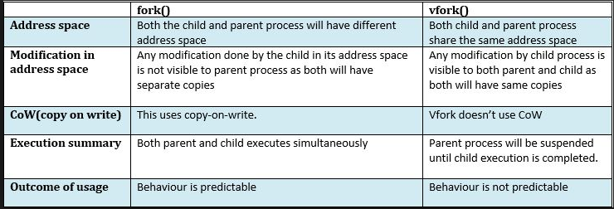
fork vs vfork

Slide 35
Sample code using vfork system call:
int main(void)
{
pid_t pid;
pid=vfork();
if (pid==0)
{
printf("I am a child process\n");
printf(“Child process ID : %d \n", getpid());
printf("Child's Parent process ID : %d ",getppid());
_exit(0);
}
else
{
printf("I am a parent process\n");
printf(“Parent process ID : %d \n",getpid());
printf("Parent's parent ID(Shell id) : %d\n",getppid());
}
}

Slide 36
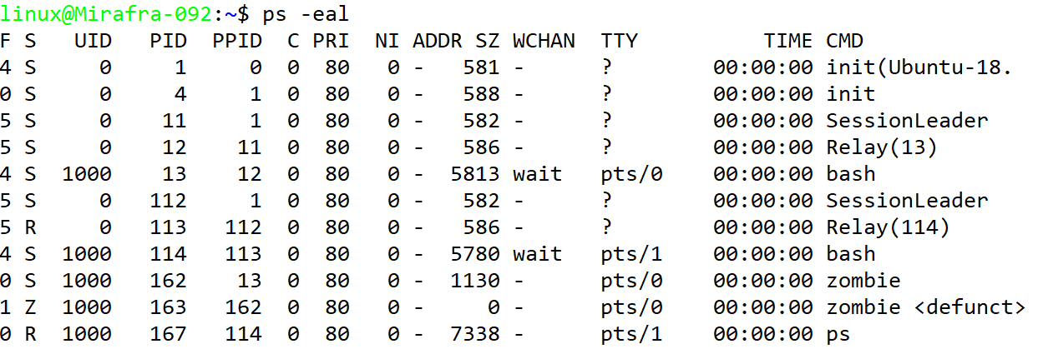
ps command reports the process status

Slide 37
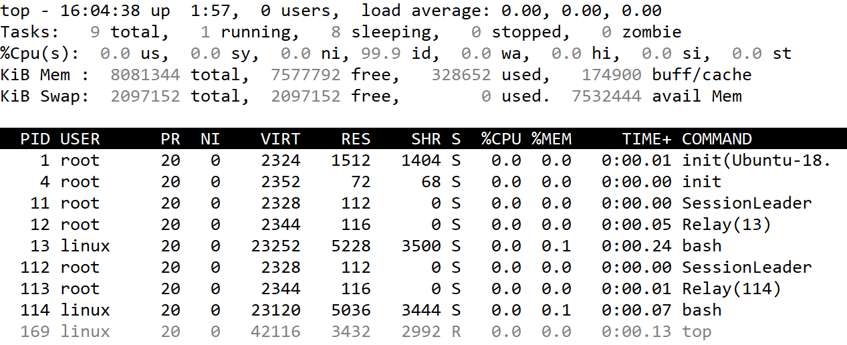
top command displays the CPU usage of the process

Slide 38
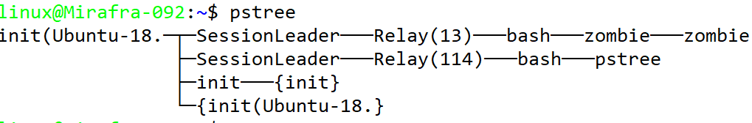
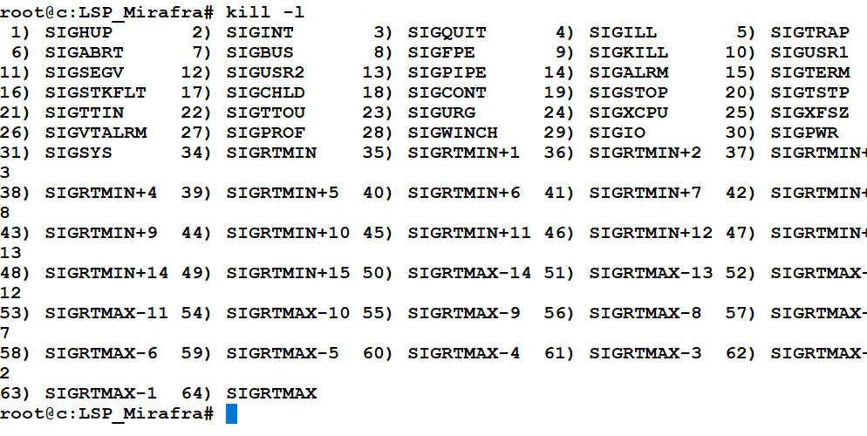
pstree command displays the process tree
kill command used to terminate the process

Slide 39
Process Management:
nice
Run a program with modified scheduling priority
Example:
nice +n command
renice
Alter priority of running processes
renice command syntax:
The renice command changes the nice value of a process already running.
It's syntax is as follows:
renice {priority} pid
The following will change nice value of process 2243 to 19, enter
# renice 19 2243

Slide 40
Thank You…

